Slide 1

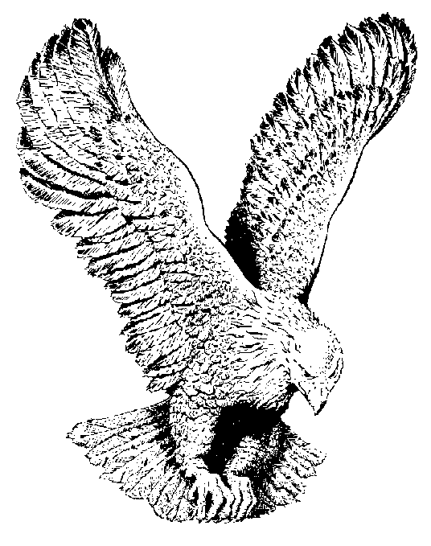
MY FEET ARE ON THE PATHWAY
My feet are on the pathway,
The oil is on my head
I’m drinking at the fountain,
Feasting on the Bread.
My mouth is filled with laughter,
My heart is filled with song.
I’ll praise my Saviour all day long.
Hallelujah! Hallelujah!
I’ll praise my Saviour all day long. (repeat)

